Slide 1
IPC: File IO and Standards
Combination

Slide 2
TODO
Use case being using other people's software? Or bring that up hardcore later?
Systemd and systemctl - In the linux lesson? Do this in a dedicated library lesson?
Using other people's code? Installing, frameworks, libraries, modules, etc
Put in the abstractions / patterns section?
It feels like the main value of this is reuse of code and services so I don’t have too, so should I not promote that way more?
Talk about some of the applications of each IPC during each so this lesson feels worthwhile.
Propose how to make a package manager?
Notes:
Did you write it
We can technically do everything from scratch
But we usually use other people's code. Either services, or raw code.
Daemons, services, etc
libraries and frameworks and transpilers. These are code components

Slide 3
Announcements
Project part 2

Slide 4
Review
OS
Syscalls
Processes
Linux
Man pages
Notes:
OS: Our interface to hardware
Syscalls: Functions to interface with OS
Processes: Programs running on and managed by the Operating System
Linux: Operating System that runs the world
Having a good understanding of Linux was critical to every TAMID Project I have done

Slide 5
RTFM

Slide 6
Pre Lesson

Slide 7
Using other people’s Code and Programs
Notes:
This is a sorta rant sorta not
What we are focusing on is writing code from scratch, and understanding the underlying concepts - To such a degree that given any technology, you can at least understand how it was created, and if needed you can get started making your own version with some help from google.
However, that’s of course, challenging, and time consuming. I don’t expect you to write everything from scratch in practice, that’s insane. Lets install some stuff
So how do we get things on our computer, and what are we even getting?
Executables
Eg. ls, pwd, cat, touch
Services
Eg. Database, systemd
Code to put in our codebases
Libraries
Module exporting many functions with similar purpose)
eg. math
Frameworks
(Base layer abstraction you build off of)
Since python is in C, I kinda of view python as a framework over C - Although some computer scientists might punch you
You can make these yourselves, they are not some divine magic.
How?
Ask in person LOL
Download from the internet (github, personal sites, etc) - You might have to build the code from source files which might be a pain
Use specialized programs called package managers (They download from the internet in a controlled way)
These are programs that download programs from online. What we install could be a general tool, or some code to use in our codebase.
Examples:
Computer wide: apt, brew => Can install executables like batcat
Programming language specific (generally for libraries and frameworks) : pip (python), npm (javascript), maven/gradle (java), apt ©
Note how apt is used to install libraries and computer wide programs,
A note on current programming:
Kind of a range from low dependency to high.
What yo find today… Glue oriented programming
The skillset is a bit different
Finding dependencies
Installing dependencies
Dependency management
Reading documentation (you still do this less from scratch, but if everything you are doing is through a new library, you’re going to be hitting the documentation pretty frequently
We will play around with other people's code / services later.
Notes:
when you install code from online. You can look at it. Debug it. You are an engineer.
Don’t define yourself by any particular framework. You are an engineer. Be flexible
You may think this is contradictory since I have a strong C and Linux focus (and you can think of linux as a framework for using hardware)
A note on CS also being a tool - Have friends, look at other domains and whatnot.
There is no best framework, and no correct one. They are tools. Be critical of your tools.
stfu about react

Slide 8
Theory Section

Slide 9
Systems
A system is a group of interacting or interrelated elements that act according to a set of rules to form a unified whole
Notes:
From now on, I want you to think about them in terms of interface, and object. We have seen this before. Once you can abstract and think about systems. Most STEM domains are pretty straightforward. Then it's just a bunch of memorization.
Systems are everywhere

Slide 10
Systems: PCAP
Primitives (Syscalls, Processes, Memory, Hardware, OS)
Combination
Abstractions
Patterns
Notes:
If you are interested in some patterns, look at design pattern by the Gang of 4. I can’t guarantee they are good, but it’s nice to get your brain a little more solid.
Something else to note about systems is that they are recursive. Its up to you to decide what the primitives are. For our purposes, the operating system offers our primitives.

Slide 11
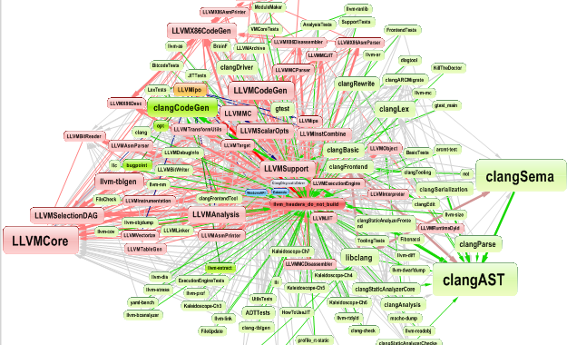
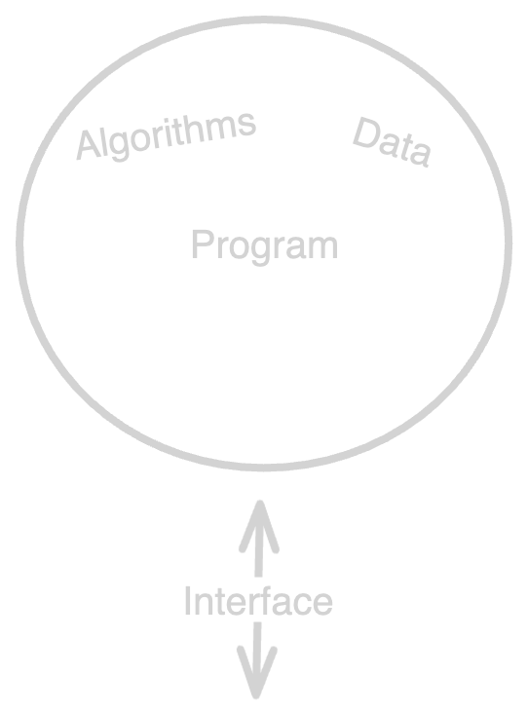
Today: Combination
Into this!
Turning this…
Operating System
Notes:
HOW I THINK OF THIS ALL, IS AS THE INTERFACE. Everything here is about creating Interfaces. I view every system through the interfaces. The communication, the flow of data. It’s all interfaces.

Slide 12
Lenses of creating systems
Why? Performance vs Abstraction vs Modularity vs
Emergent Features vs IO
Method of combination? Code or Services
Notes:
Why
Performance
Modular / Abstracted systems
Easier to reason about
Swappable components
Use components built by other people
Super important for scalability of systems- side tangent about biology, the ultimate “I made it myself”
IO
All IO we have done so far (Command line) - is a part of the system
Emergent features
Computer networking, accessing other computers
Abstraction
Modules, Libraries, Frameworks
We are going to mainly focus on #2, especially C. The reason is because 1. System Design class focuses on this. But also because you must be able to create working systems before you think about their performance.
Methods of combination
what are the strings between components made of?
Just adding code to existing programs
Creating new programs to interact with existing programs
How?
Functions, Modules, Libraries, Frameworks
IPC - Inter process communication

Slide 13
From now on we are focusing on communication between services
Notes:
Yall already know how to create modules, and as such they are not that interesting.
Communication between services:
For the longest time - I thought there was some crazy deep magic to how things worked together. Nope. It’s pretty simple, they are just all communicating through these channels or some abstraction using these, and it's all managed by the operating system.

Slide 14
Basic Operations for Combination
Being able to communicate
Speaking the same language

Slide 15
2 Important Operations
Being able to communicate → Interprocess Communication
Speaking the same language → Standards
Notes:
Draw this out!!!!

Slide 16
Communication: Interprocess Communication
How processes to interact with each other
Signals
Pipes (Anonymous and Domain)
Sockets
Files
Events
Shared Memory
Wiki: https://en.wikipedia.org/wiki/Inter-process_communication
Notes:
Implemented as system calls since this relies on the operating system
We will look at how to use these mechanisms in the coding section. I want you all to really internalize this. For now I want you to imagine this as message passing. Since its essentially data transfer.
Most important concept next to processes and system calls. The patterns and abstractions you have access to now are unrivaled. We will touch on some of those later

Slide 17
Use Cases
Transfer Data.
Interact with any program / Service.
Create highly performant systems.
Notes:
The amount of abstractions you can create with these are absurd
Interact with anything:
eg. tell window manager to send notification
(eg. Debugger)
(grep within your python script)
(eg. IRC, websites)

Slide 18
Speaking the same language: Standards
Notes:
What IPC provides is the ability to send messages. What we need to do now is assign meaning to the messages.
A protocol is a textual agreement (think a document) that specifies exactly how each message should be interpreted.
For byte stream based IPC - Having an “agreement” for what format the text messages should be is very important.
Examples:
Programming interaction between Human and a Turnstile
Logger mechanism - 2 programs that can send plain text messages to each other: debug, info, warning, error, critical
We will touch on this heavily throughout our education through case studies and our networking section.

Slide 19
Example
TODO: Shell Protocol
we can do args first - all convention

Slide 20
Protocol Example
Mail Server
TODO: Show actual example - then work through

Slide 21
Case Studies
Post Office Protocol Version 3 (POP3)

Slide 22
Review
Systems
Basic operations for combination
Interprocess communication
Protocols
Most programs are designed to be interacted with.
Notes:
Something to note is while this is thought the lens of computer programming, many of the concepts
Regarding the last point:
You can also use an existing library to interact with programs, under the hood though they are just following the specification and using IPC or some abstraction over existing IPC,
About existing libraries, you may find some aren’t very good. Could be bad abstraction, buggy, incomplete, or otherwise lacking. Fear not because now you know how to create your own.

Slide 23
Hands on Section

Slide 24
File’s in Linux
Everything Is a File
eg. /proc, all IO, timers, process fd, clock fd, IPC
File Descriptors
open(2), fcntl(2), dup, dup2
Notes:
Everything is a File
Open, Close, Read, Write
All IPC is treated as a file because you can open, close, read, write, etc
File Descriptors
How the OS lets us interact with files
A number the OS gives us for each file, that we can call functions on. (Show example)
Every processes has its own File Descriptor table
File Descriptors are inherited from parent processes unless we specify otherwise.
By default has Stdin, stdout, stderr which are default file descriptors.
There however are file descriptions which are global?
The relationship between a terminal and a shell is wacky, I don’t understand it, something to do with TTY and PTS
Can

Slide 25
Question: Why did our Shell’s child processes print to the same output?
Notes:
Answer: Standard Input, output, and Error (stdin, stdout, stderr) are file descriptors, and as such are inherited by child processes unless otherwise specified

Slide 26
Hands on 3.1: Pipes
Create a pipe using the pipe() system call.
Fork a child process using fork().
In the parent process, write a message to the pipe and close the writing end.
In the child process, read the message from the pipe and print it to standard output. Close the reading end after reading.

Slide 27
Hands on 3.2: Pipes
Pipe Yeller:
Similar as the last program, but instead of printing to stdout, sends back to the parent process capitalized - Which will then print it out.
Notes:
Go over what the system would look like

Slide 28
Hands on 2: Sending Signals
Signals are typically used to instruct a daemon/service to do something such as restart, exit, reload configuration, clean cache, and more!
Notes:
Systemd sample
TODO: Send signals to existing daemons and see how they react, use systemd
Hands on using signals, inheriting signal handlers, get a feel

Slide 29
Hands on: Systemd

Slide 30
Project: Part 2
Notes:
Go over basic concept

Slide 31
Resources
File Descriptors: open(2), close(2), dup(2), dup2(2)
Signal: sigaction(2), kill(1)
Pipe: pipe(2), pipe(7), popen(2)
Socket: socket(2), bind(2), connect(2), listen(2), nc(1)
Shared Memory: shmget(2), mmap(2), clone(2)
Files: open(2), close(2), read(2), write(2), dup(2), lseek(2)
Notes:
After each item, brainstorm things you can do with it.
Signal: Very simple communication - there are a number of known signals you can send
Pipe: Unidirectional data transmission (bytestream)
Socket:

Slide 32
C Programming Language
Doesn’t have OOP! Oorah!
Notes:
Built at the same time as Unix (Predecessor of Linux), by many of the same people
Easy to learn, difficult to master.
Access to fundamental Interfaces
Low level = Close to the hardware

Slide 33
Todays examples:
Logging module
Logging service (daemon)
Notes:
Logging Module
We will quickly go over modules and libraries since you all know how to make them. Just create a file. And export some functionality. If you are interested in how to make a
Design
Pros and Cons?

Slide 34
2 Options for Project
Simple Debugger for C programs
Mail Daemon
Case study?
Then think of how to implement specific technologies?
Example to hack into existing running daemons or programs?
Notes:
https://blog.tartanllama.xyz/writing-a-linux-debugger-setup/

Slide 35
TODO
Full introduction to systems
Move hands on 1 to previous lesson

Slide 36
Processes
Notes:
A program executing on your computer - Managed by the operating system - os is just a program
Represented and managed by the OS as a data structure called process control block
There are many processes running on computer. Since computer can only run 1 thing at a time, managed by a “Scheduler”.
When a process is started (can only be started by another process via system call, or by being the very first process),
OS assigns a unique “Process ID” and entry is added to primary Process Table
Memory is allocated for actual program (stack, heap, data, etc) and the “Process Control Block”
PCB is data structure the OS uses to manage and schedule a process
The process’s allocated memory is referenced by the PCB
Process gets: argv, envp, file descriptors (inherits open files), signal handlers

Slide 37
Some Process System Calls
fork(2)
execve(2)
wait(2)
_exit(2)
kill(2)
nice(2)
Notes:
Many System calls are used to manage processes (creation, deletion, etc)
There are way more commands, see the “SEE ALSO” section of the manpages for related commands.

Slide 38
Hands on 1: Process Control
Simple Shell Program: Create a shell which can execute simple commands and programs
Hint: Use fork(2), execve(2), and wait(2)

Slide 39
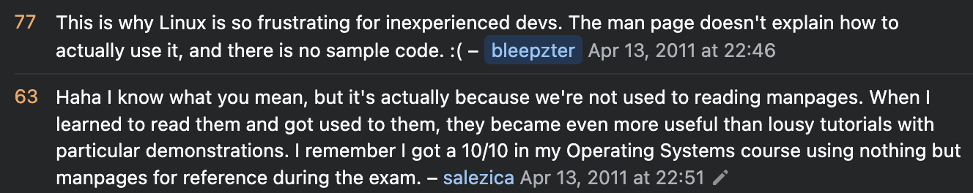

Slide 40
Why
Why not make a monolith?

Slide 41
What can we do with Combination
Create more performant systems (Service only)
Create modular/abstracted Systems
Notes:
Modular / Abstracted systems
Easier to reason about
Swappable components
Use components built by other people
We are going to mainly focus on #2, especially C. The reason is because 1. System Design class focuses on this. But also because you must be able to create working systems before you think about their performance.
Show how this is possible

Slide 42
2. Methods of combination
Within your existing process (Program)
Using more processes (Services)
Notes:
How?
Functions, Modules, Libraries, Frameworks
IPC - Inter process communication

Slide 43
Who made it?
Us
Someone else

Slide 44
How to use Combination for Benefits
 | Performance | Modularity + Abstraction
Program | N/A | Functions, Modules, Libraries, Frameworks, etc
Using Services | Multiprocessing and Multithreading More programs = more compute power! Run programs on different machines = more compute power! Run programs | IPC Separate your program into many communicating programs Use existing services Easily swap out services
Notes:
You can improve Performance of code, but not due to using combination. A single process with more code will not perform any better. Remember, this is about creating systems.

Slide 45
First Project: C Debugger
TODO:
Should take argument variables for config
Also have config file
Also takes signals
Process control, runs the C program by fork/execing it
Have windows users install wsl to use glibc
Whats next: File descriptors

